Slide 1

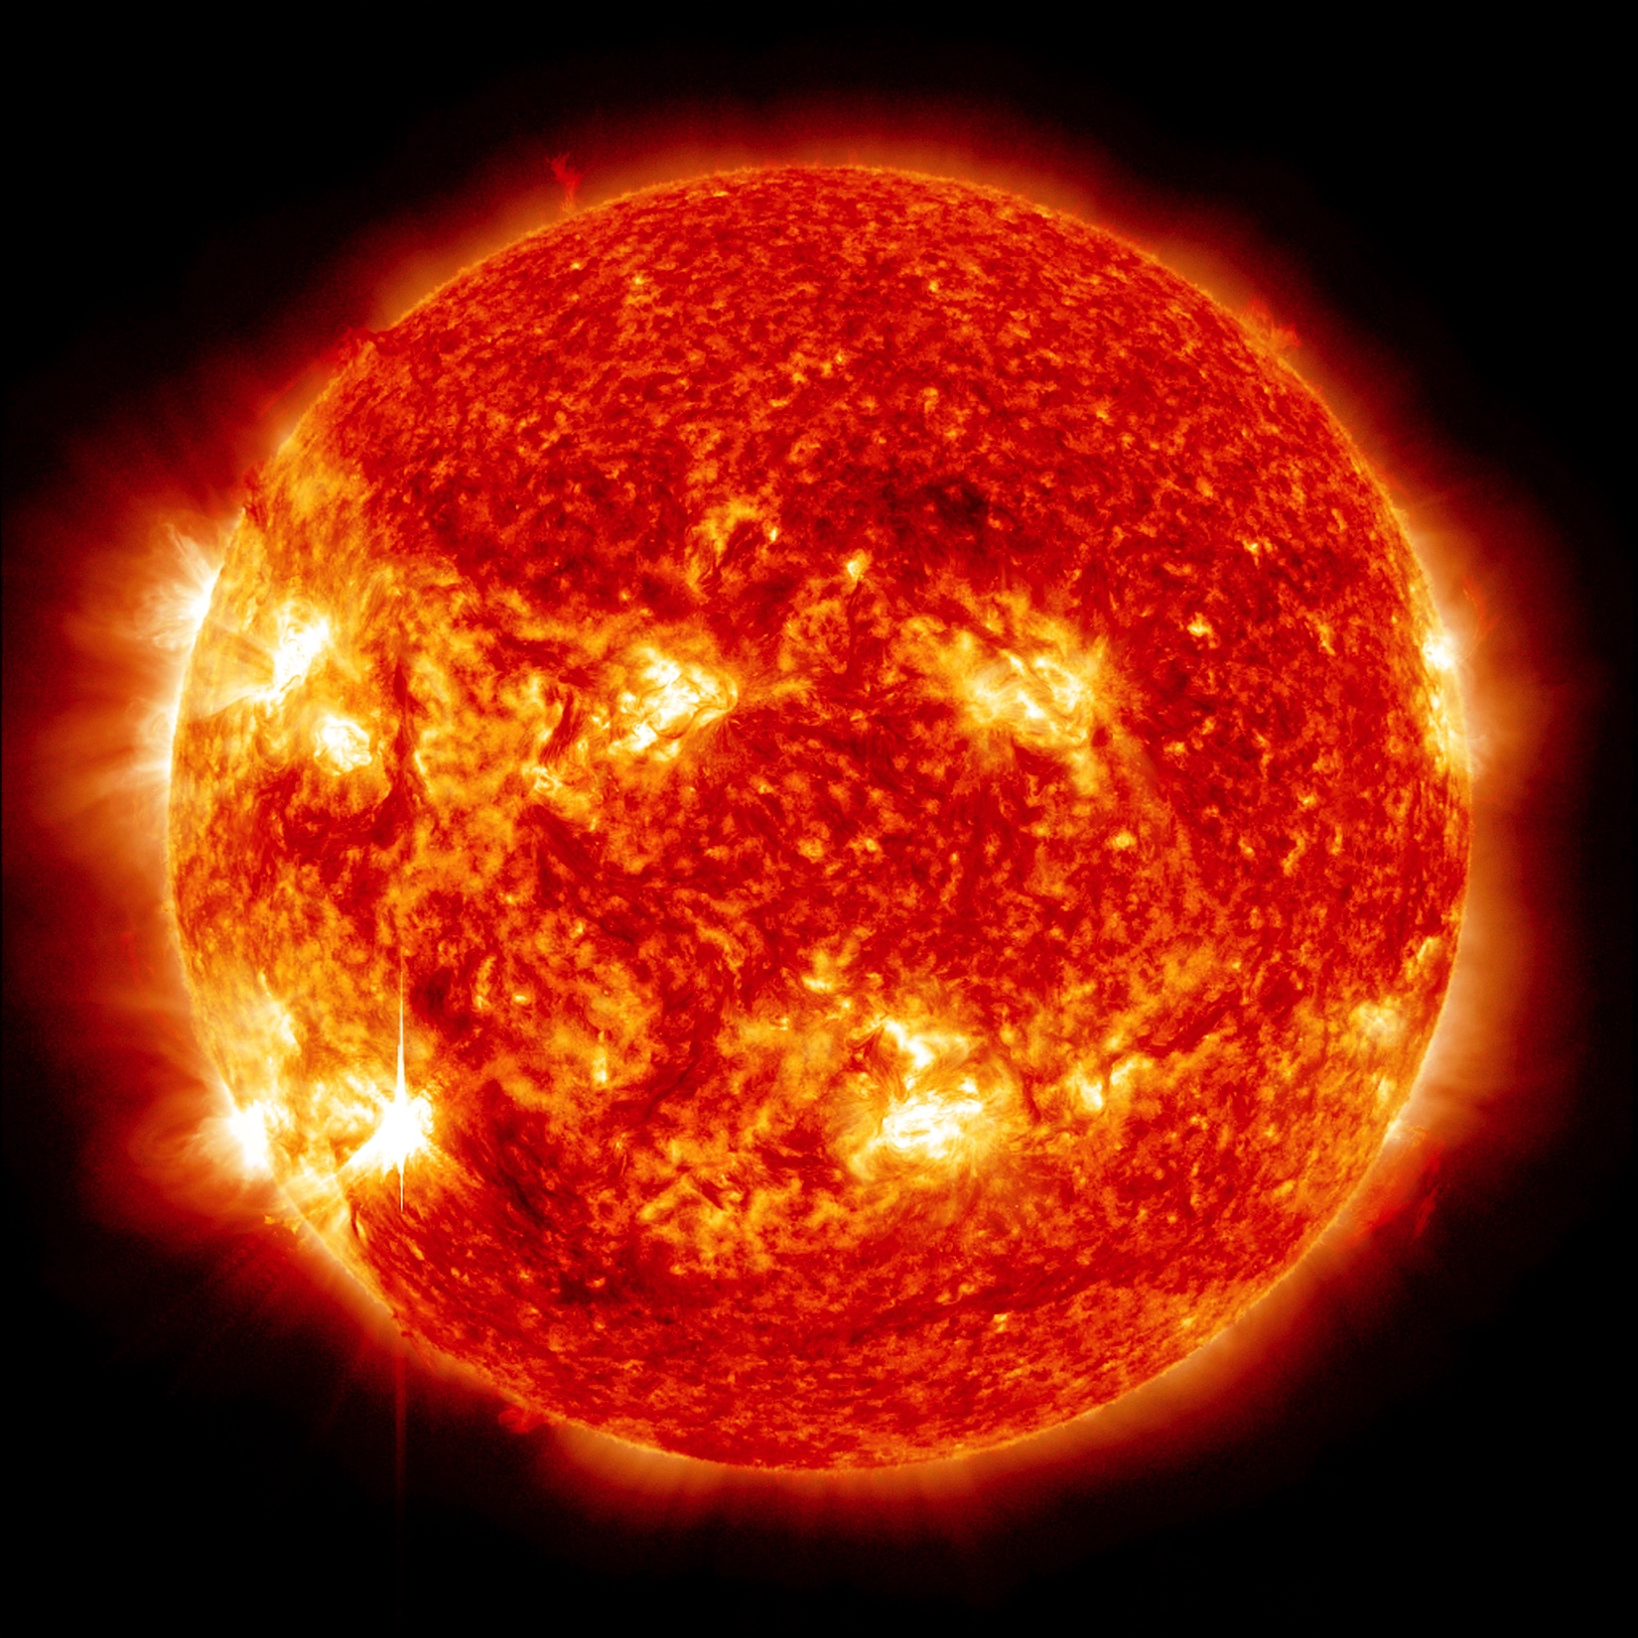
Modeling the influence of photospheric turbulence on solar flare statistics
Miller Mendoza Jiménez
Collaborations: A. Kaydul, T. Koskamp, L. de Arcangelis, J. S. Soares Jr., H. J. Herrmann
Notes:
/home/mmendozaj/ETH-design/presentation-openoffice/template_praesentation_oo.odp

Slide 2

What are solar flares??

Slide 3
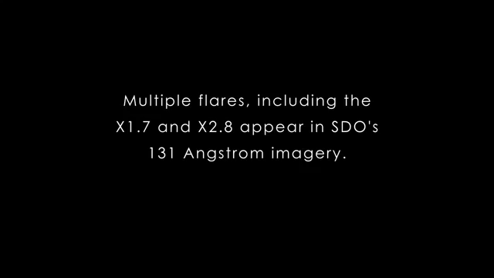
X-ray video of the Sun

Slide 4
Why is it important?

Slide 5
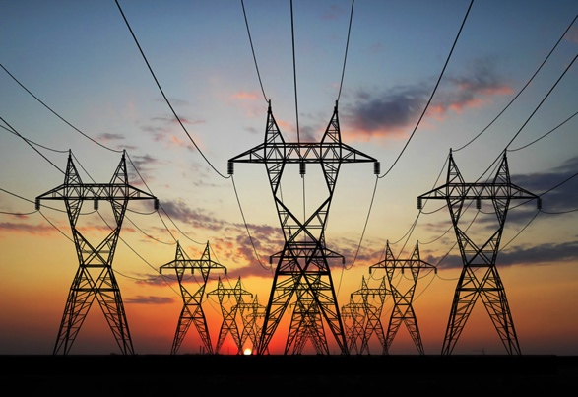
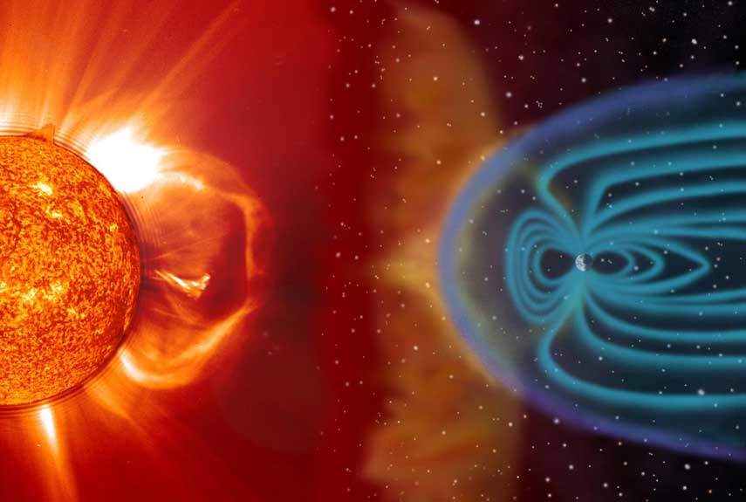
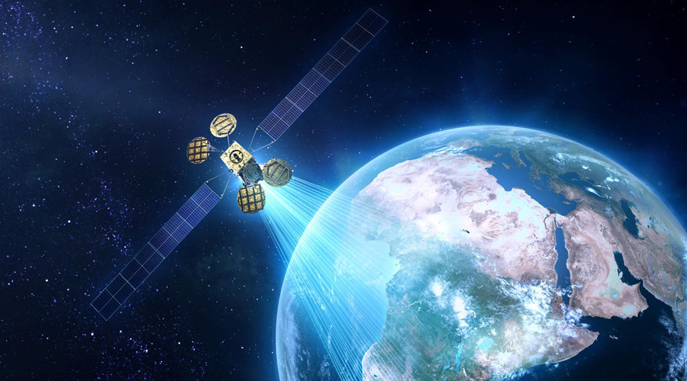
Impact on our lives
CME: Coronal Mass Ejections
Magnetic Storms

Slide 6
Magnetohydrodynamics
Magnetic lines are frozen in a highly conductive plasma
Parker, E., Theory. Solar Phys. 121, 271–288 (1989).

Slide 7
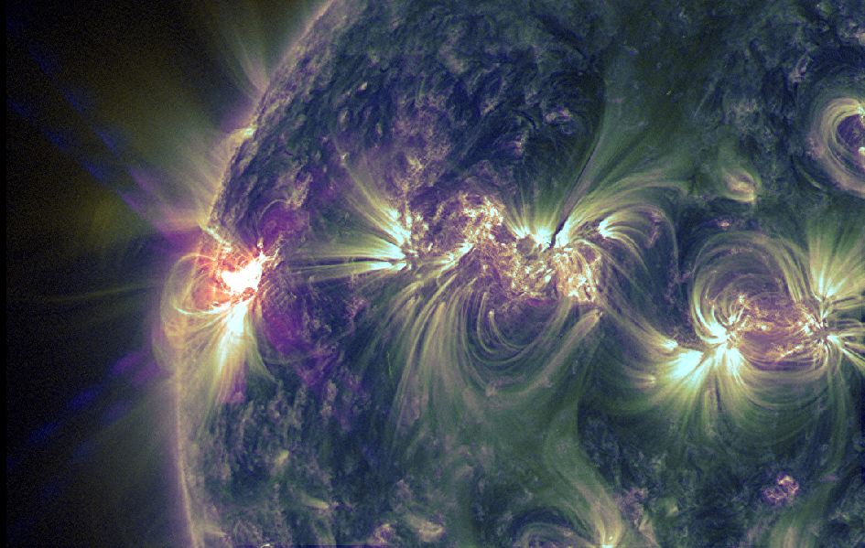
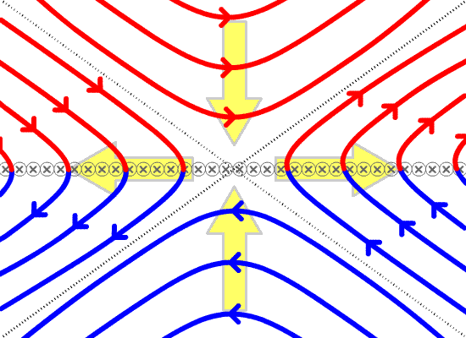
Causes of Solar Flares
However, still an open Question !!
Magnetic
Field Lines
Current
Sheet
Magnetic
Reconnection
Diffusion
Region
Random motion of footprints
Parker, E., Theory. Solar Phys. 121, 271–288 (1989).

Slide 8
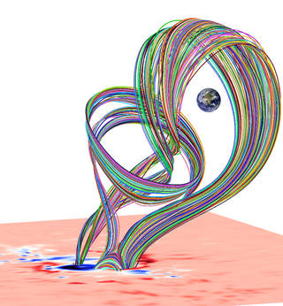
First principles simulations in 3D
Requires tooooooo much computational power!!
Parker, E., Theory. Solar Phys. 121, 271–288 (1989).

Slide 9
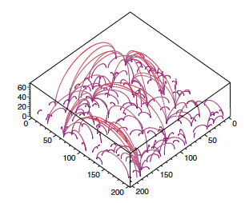
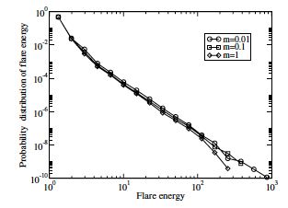
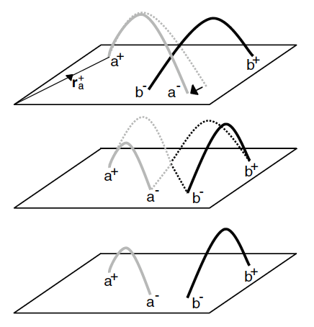
Model based on self-organized criticality (SOC)
Exponent = -3. Expected value ~ 1.68
Inter-time distribution: Poisson (not expected)
D. Hughes, et al. Phys. Rev. Lett. 90, 131101 (2003)
There are many more works studying this phenomenon.

Slide 10
Model Description
Exponent of the distribution of peak energy of solar fares ~ -1.68
Exponent of power spectrum of turbulence flow = 5/3 ~ -1.67

Slide 11
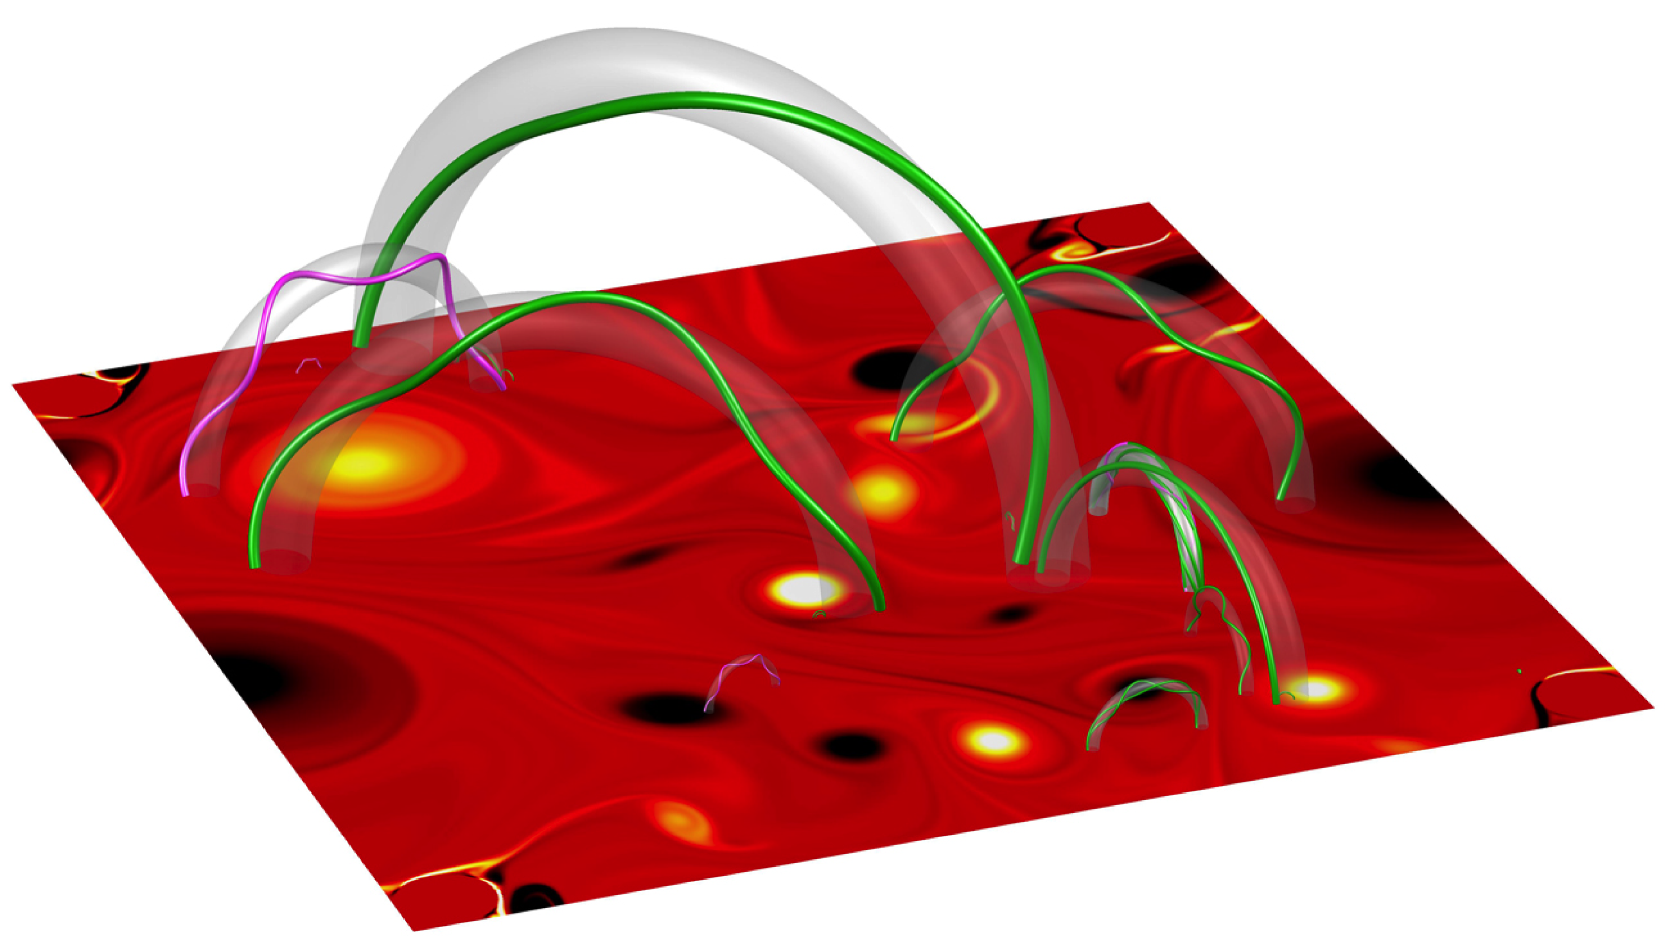
Model Description
Reconnecting
magnetic flux tube
Magnetic flux tube
Photospheric turbulence
1. Photospheric Turbulent Plasma
2. Footprints follow the velocity field (as track particles)
3. Twist is controlled by vorticity
4. Flare event affects neighboring magnetic flux tubes
Mendoza, M., et al. Nature communications 5 (2014).

Slide 12
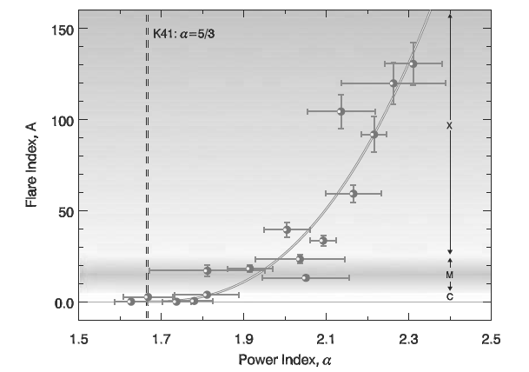
Model Description. Photospheric Plasma
Photosphere can be approximated as a two-dimensional system. Thickness ~ 500 km, Solar radius ~ 10⁶ km.
Large-scale dissipation mechanism to avoid vortex condensation.
Ekman friction
Abramenko, V. I. The Astrophysical Journal 629.2 (2005).
Mendoza, M., et al. Nature communications 5 (2014).

Slide 13
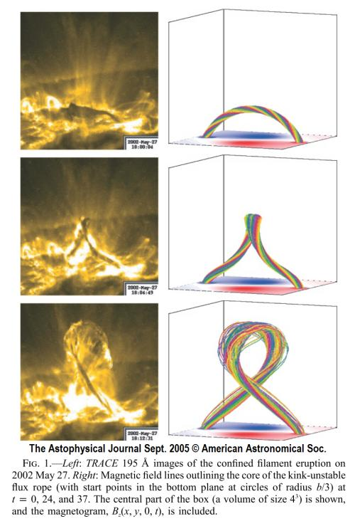
Kink Instability
Hanlon, Paul. Nature Physics (2005).
Török, T. & Kliem, B. Astrophys. J. Lett. 630, L97 (2005).
Kliem, B., Titov, V. S. & Trk, T. Astron. Astrophys. 413, (2004).

Slide 14
Model Description. Magnetic Flux Tubes
Due to the freezing of the magnetic flux tubes in the photospheric flow, we move the footprints according to:
Magnetic flux tube
Mendoza, M., et al. Nature communications 5 (2014).

Slide 15
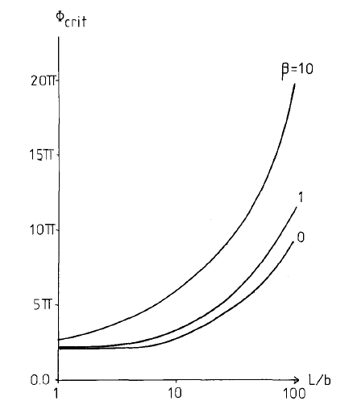
Model Description. Loop Interaction
Real picture
Hood, A. W., and E. R. Priest. solar physics 64.2 (1979)
Avalanching process: SOC
Mendoza, M., et al. Nature communications 5 (2014).

Slide 16
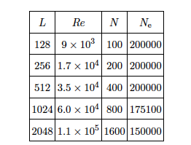
Simulation Parameters and Total Energy
Simulation parameters
Total Magnetic Energy
Mendoza, M., et al. Nature communications 5 (2014).

Slide 17
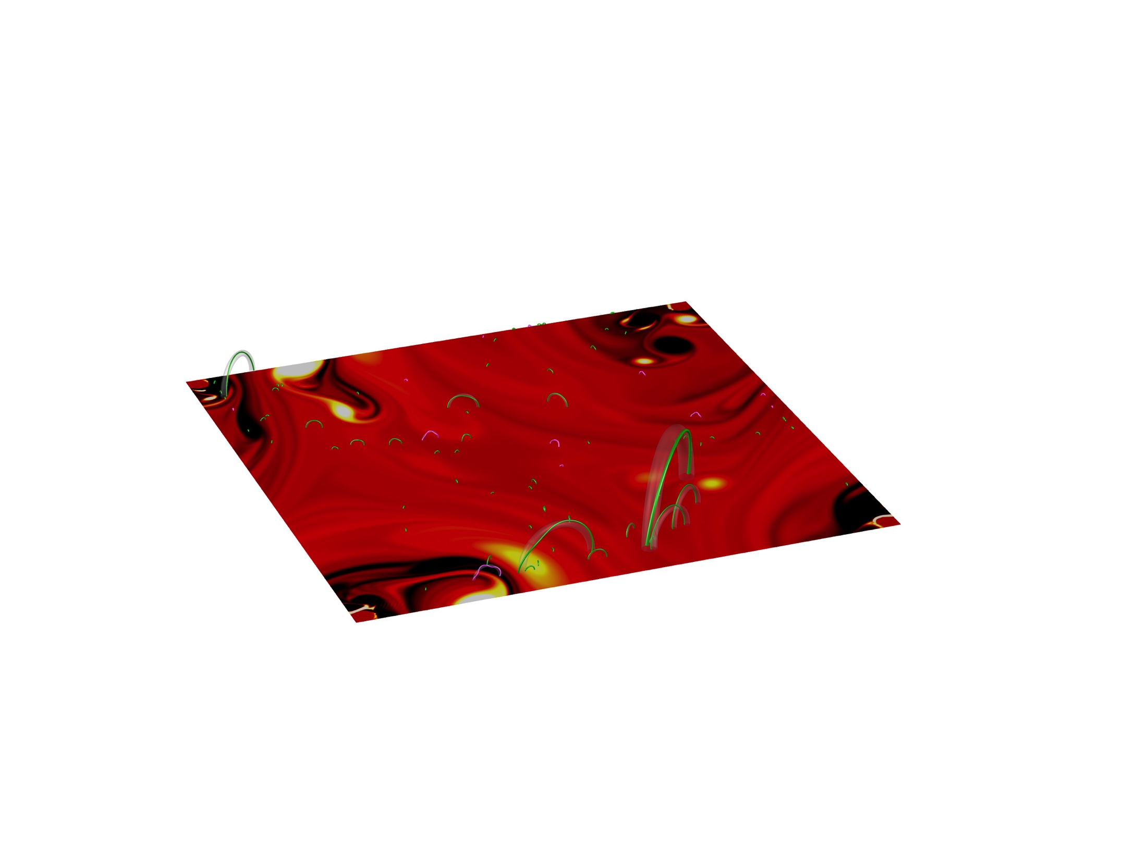
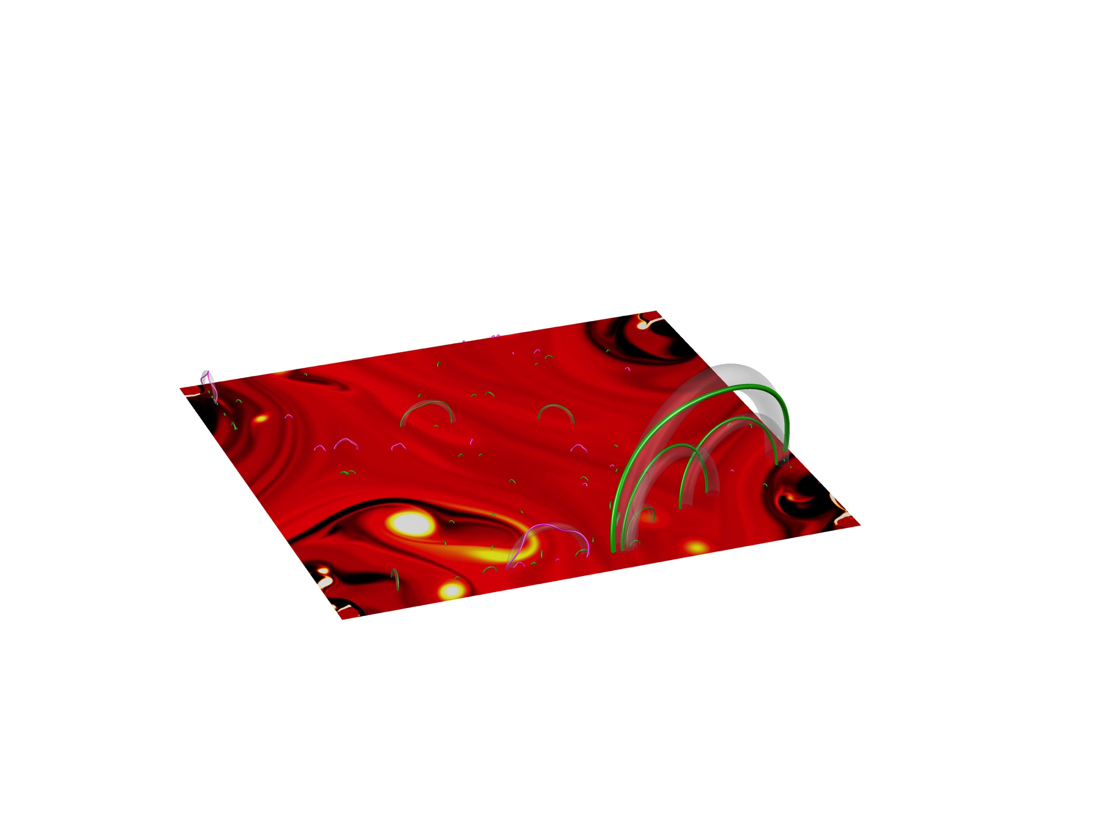
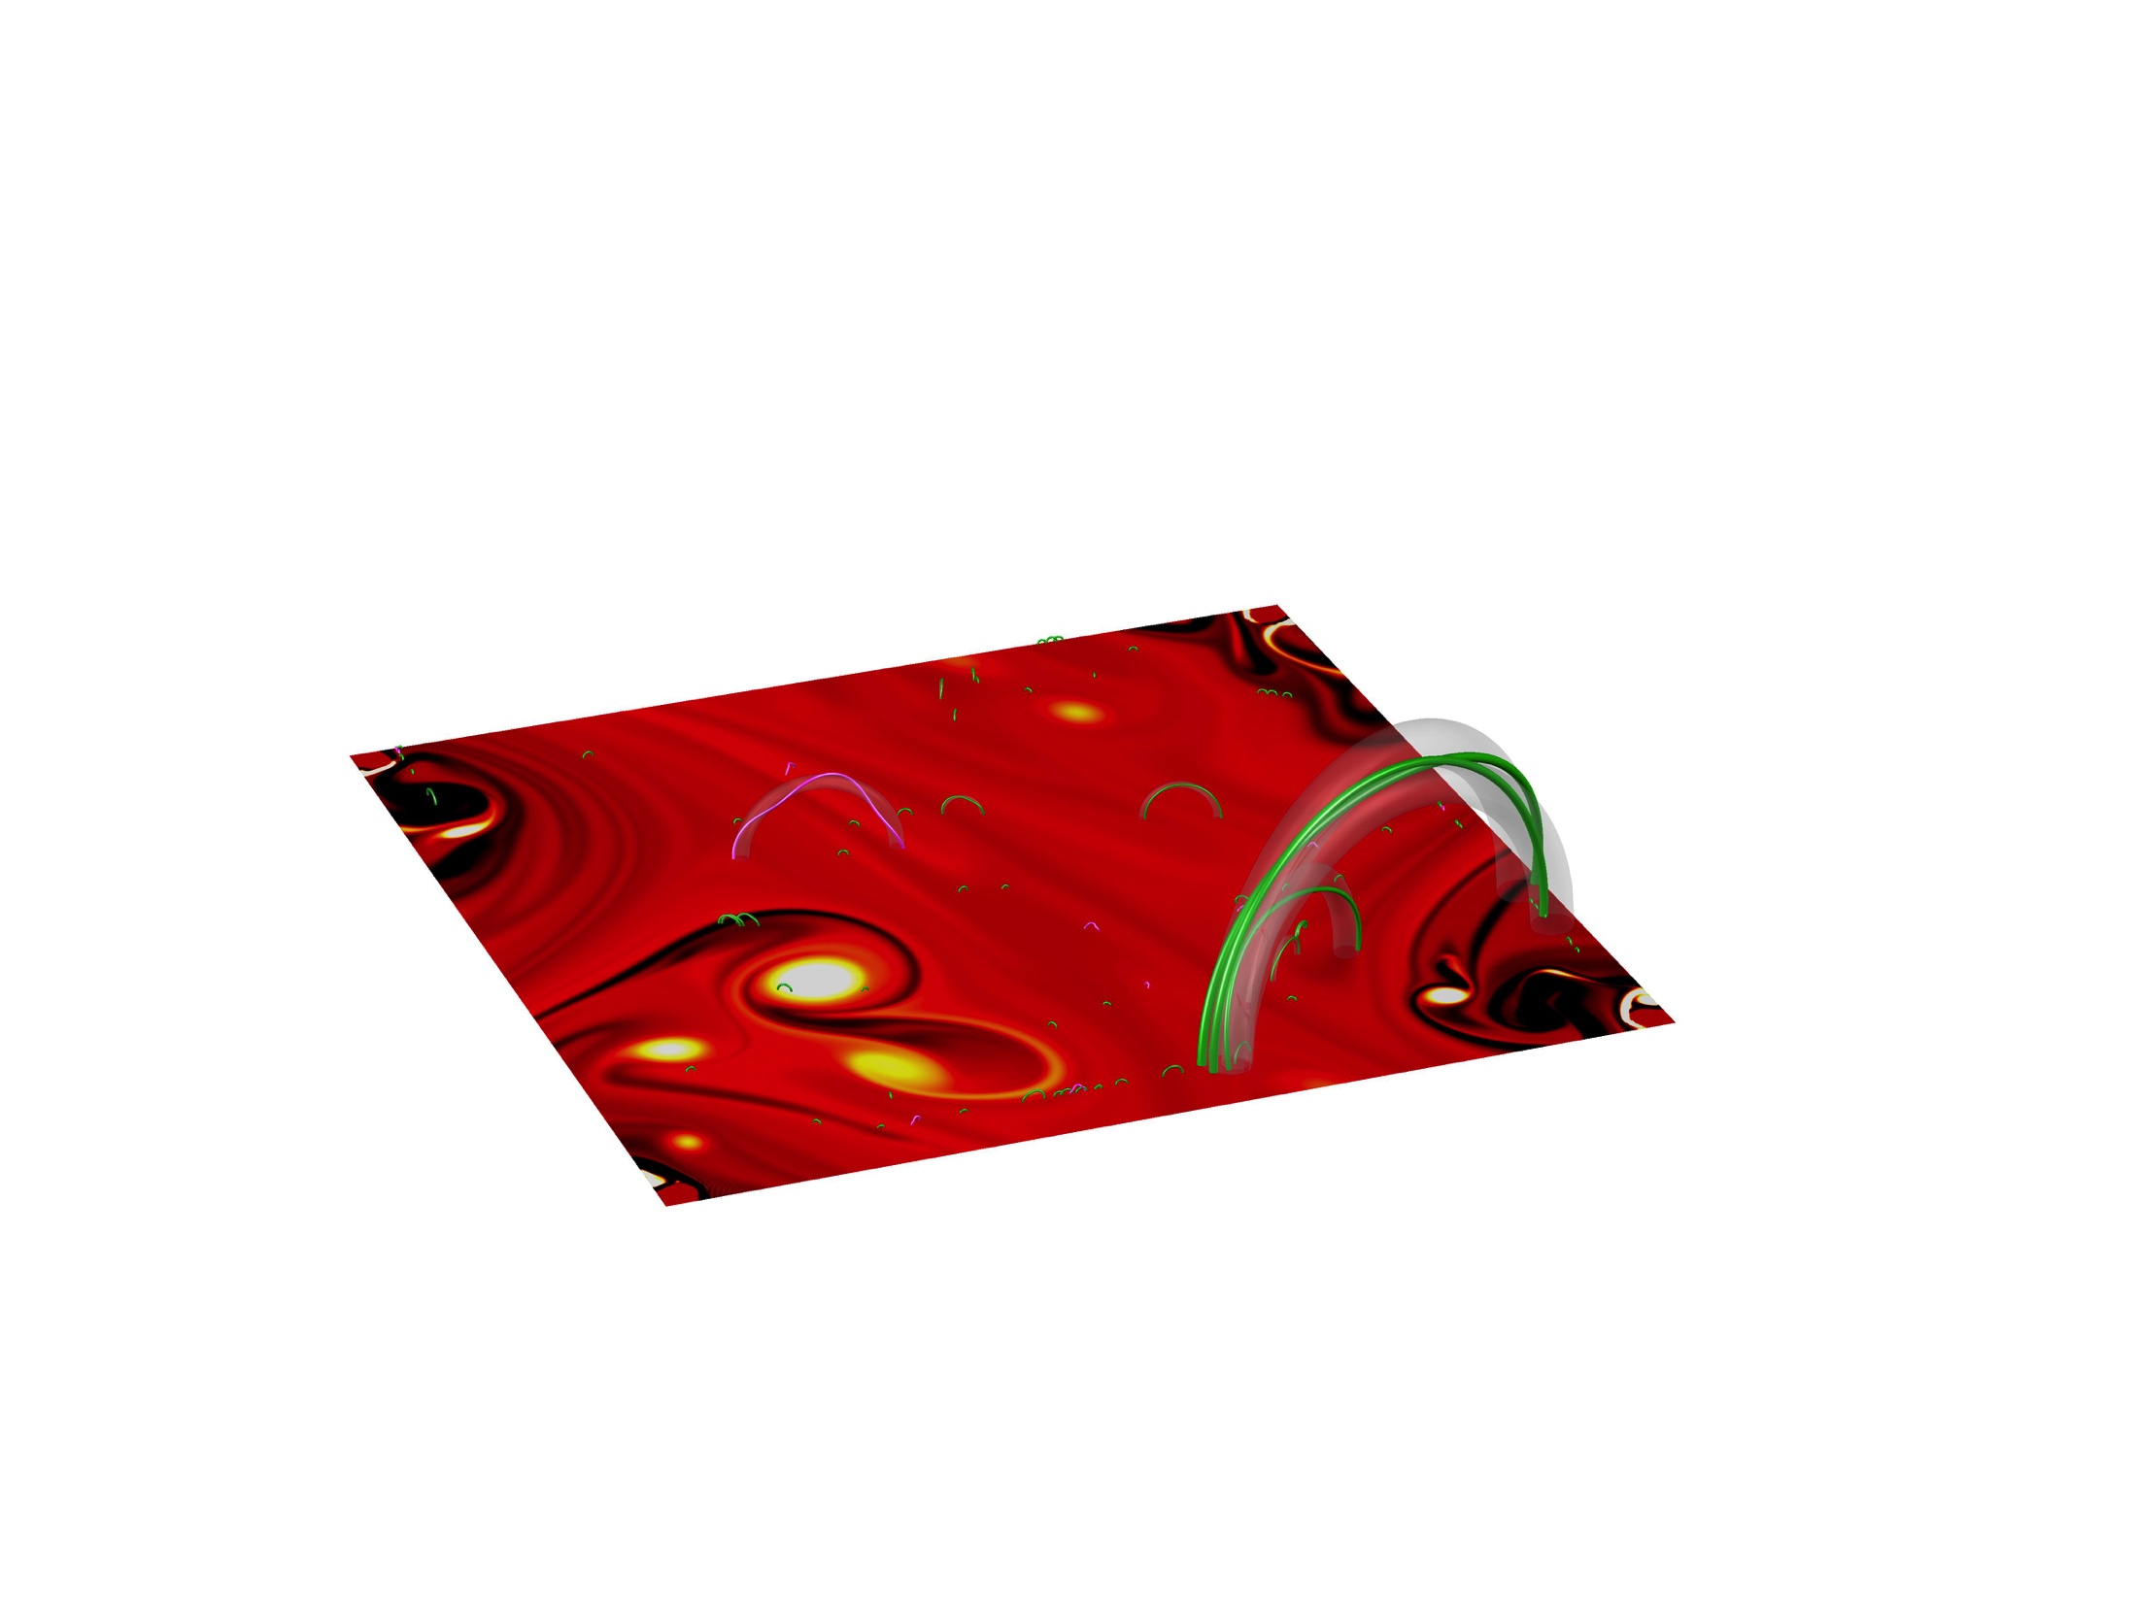
Simulation Results
Mendoza, M., et al. Nature communications 5 (2014).

Slide 18
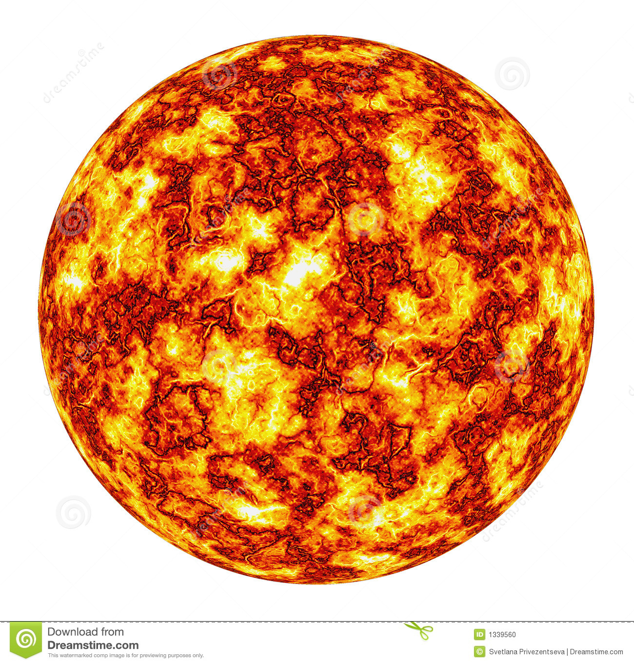
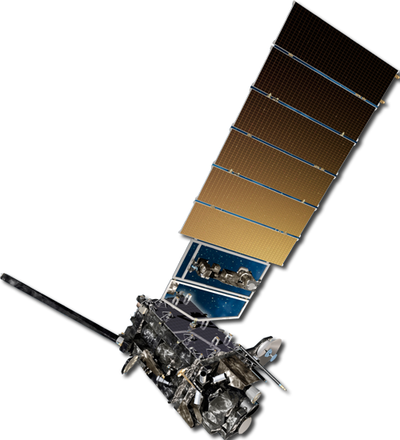
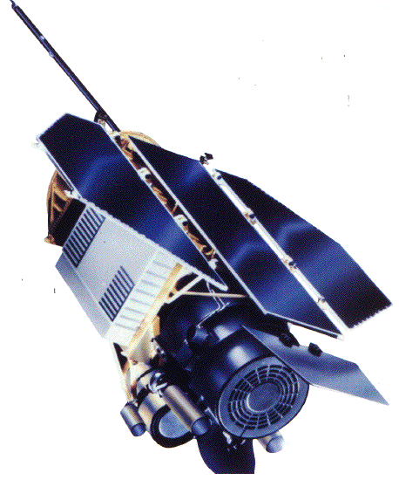
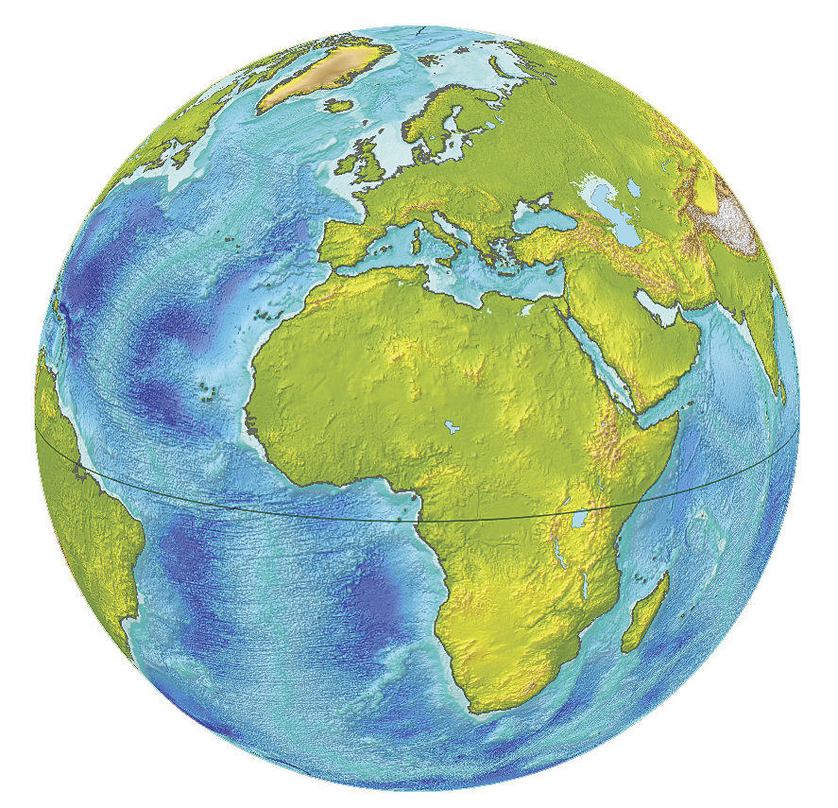
Energy Distribution of Flares
GOES
BATSE
Mendoza, M., et al. Nature communications 5 (2014).

Slide 19
Energy Distribution: A closer look
Mendoza, M., et al. Nature communications 5 (2014).

Slide 20
Inter-time Distribution of Flares
Mendoza, M., et al. Nature communications 5 (2014).

Slide 21
Inter-time Distribution: A closer look
Mendoza, M., et al. Nature communications 5 (2014).

Slide 22
Energy-Time Correlations
Mendoza, M., et al. Nature communications 5 (2014).

Slide 23
Energy-Time Correlations. A closer look
Mendoza, M., et al. Nature communications 5 (2014).

Slide 24
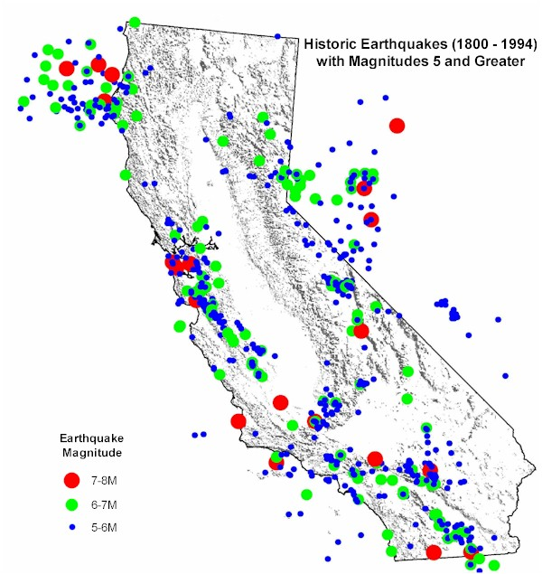
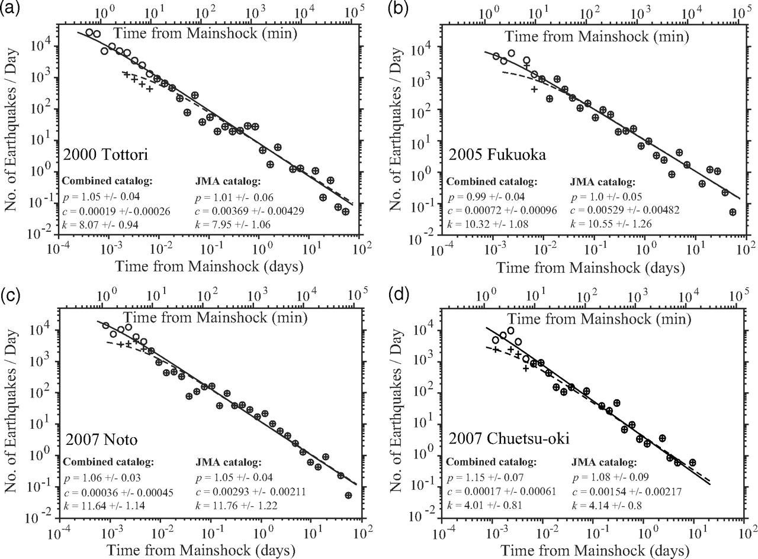
Omori’s law in Earthquakes
Number of aftershocks per unit of time
Bulletin of the Seismological Society of America April 2009 vol. 99 no. 2A 884-891

Slide 25
Omori’s law for Solar flares
No declustering: We do not know where main flares occur!!
Assuming:

Slide 26
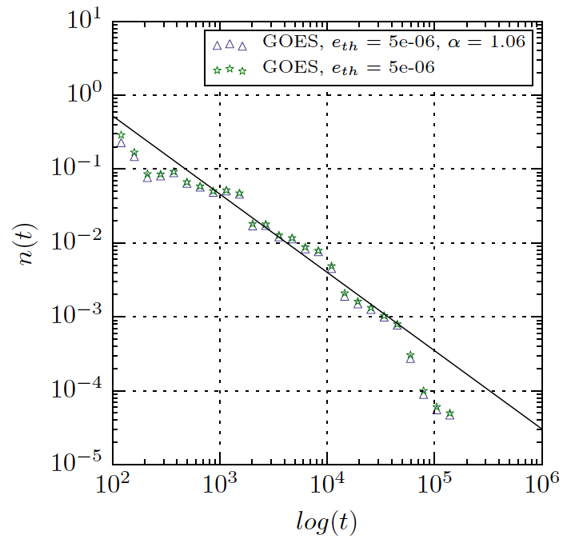
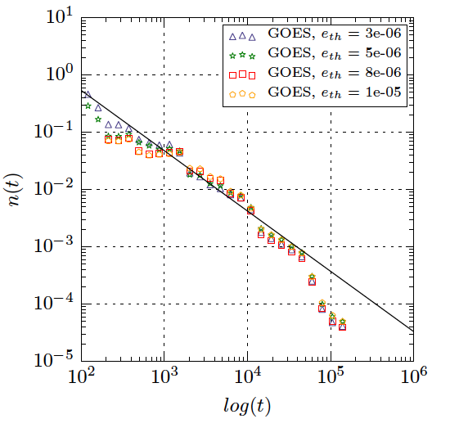
Omori’s law for Solar flares
Units:
Energy: W/m^2
Time: Hours

Slide 27
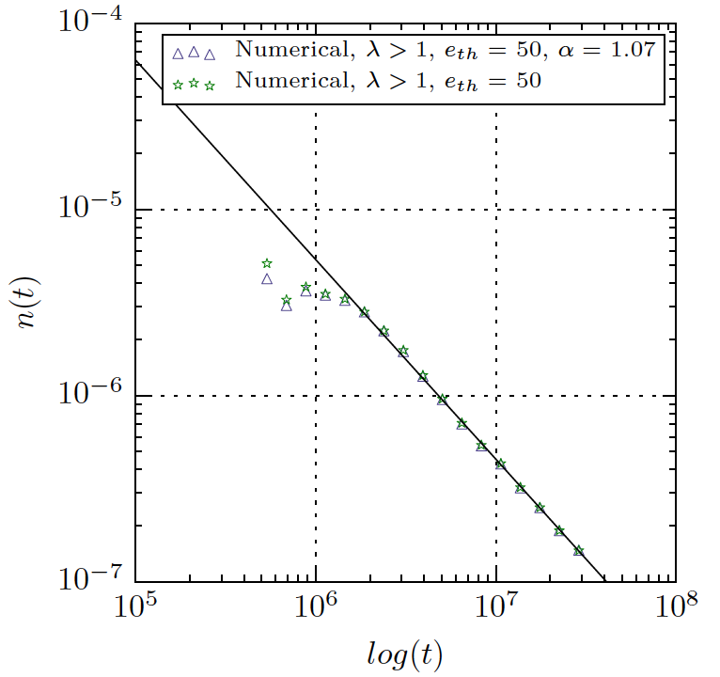
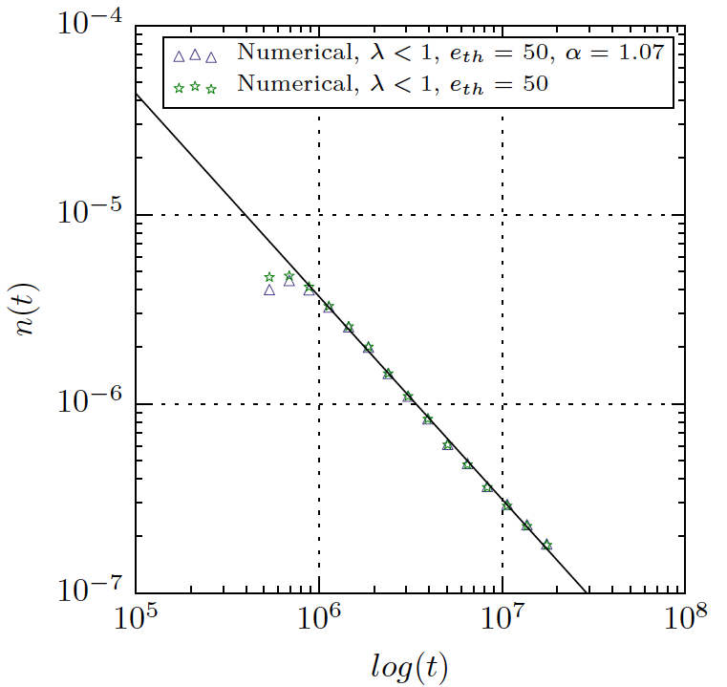
Omori’s law for Numerical Catalogues

Slide 28
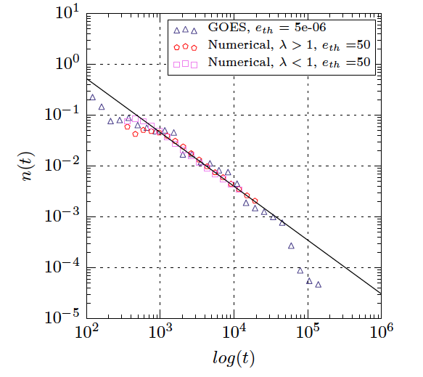
Omori’s law all together

Slide 29
Numerical Catalogues: One step forward
Main Event
After-event
After-event
After-after-event

Slide 30
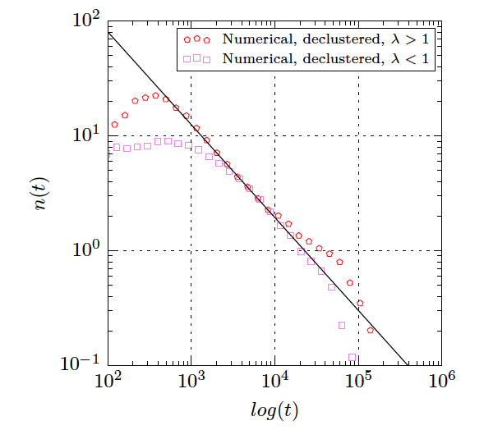
Omori’s law for declustered catalogues

Slide 31
Summary
Turbulence is the responsible for the scale free energy distribution of solar flares.
Loop-Loop interactions are responsible for the inter-time distribution.
Energy-time correlations are recovered due to loop-loop interaction and turbulence.
It is the first model capable to describe in good agreement the full statistics of solar flares, and suggest that SOC might not be the main leading mechanism in flare emission.
Omori’s law for earthquakes is also recovered. Although when one performs a declustering of the data, one finds a different exponent.
Based on our results, we make a step forward into the prediction of solar flares.

Slide 32

Thank you for your attention!

